Slide 1
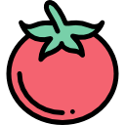






Aqua Gr wth
SOLUTIONS
Notes:
Cover Slide

Slide 2

Introduction
The Main Focus:
Our consumers - Planters and Gardeners
Desire for efficiency
Daily plant care experience
Passion for gardening and the environment
Their Opinions
Our goal
Understand our consumers' needs
Obtain different points of views
Find problems we overlooked
Notes:
Our main focus was getting an insight on people with plants and gardens and the extent of their desire for more efficient plant care. We got to understand their experience with plants, their passion for gardening and the environment, opinions on using modern technology, and opinions on the importance of water conservation. Our main purpose of this activity was to get a general opinion on our product and how we can improve it to better suit their needs. As well as
getting to know our potential consumers and what aspects of our product they find most important. We hoped to talk to a diverse group of individuals who have various experience levels and types of plants to gauge the different problems
they deal with, which will help us cater our device to aide in common plant issues.

Slide 3



Methodology
Semi-structured interviews
Identifying interviewees main problems
Diverse Demographics
Gardeners of all skill levels
Notes:
Discuss how our group aimed to cover a wide range of gardeners
Importance of semi-structured approach: Allows interviewees to describe their problems, it is easier to describe a problem, allows us to pinpoint what issues to solve
Key questions: Can you tell us about your experience with taking care of plants and whether you consider yourself an experienced gardener or more of a beginner? What are the most significant challenges you encounter while caring for your plants? Have you ever faced issues with overwatering or underwatering your plants? What tools, technologies, or solutions do you currently use to address these challenges?
Skill levels from beginners to advanced
Age range varied from young (early 20s) to old (early 70s)
Male and female interviewees

Slide 4
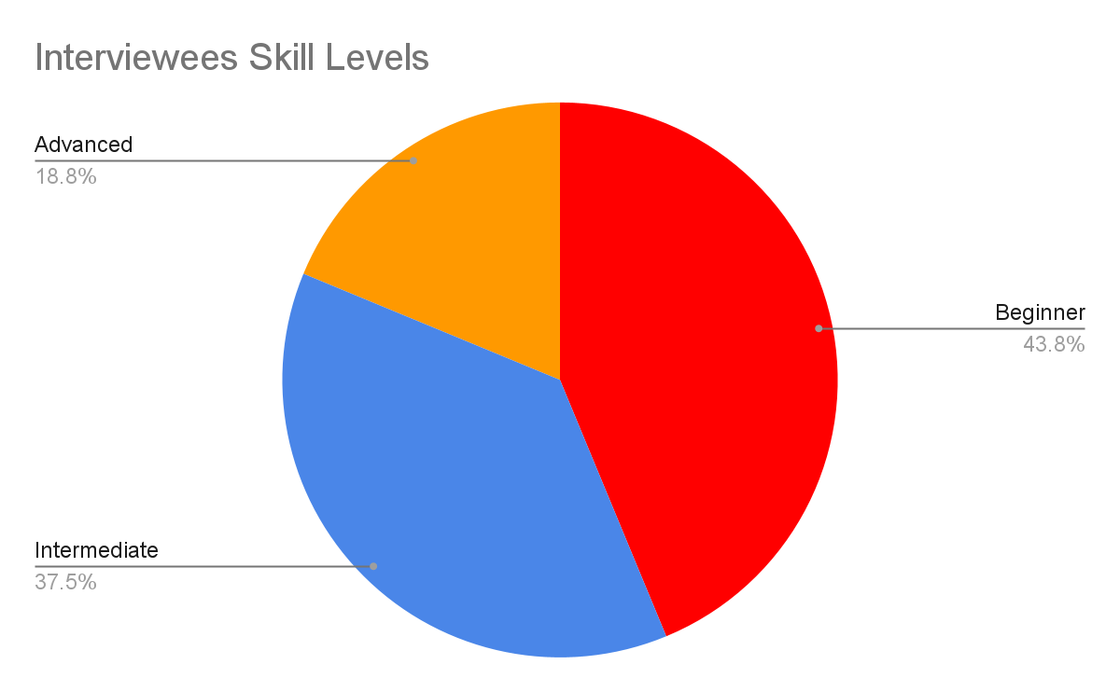

Slide 5

Key Findings
User Needs
Automation & convenience
Personalized recommendations
Real-time plant health monitoring
Simplicity
Affordability
Challenges & Pain Points
Most common watering issue: overwatering
Sunlight exposure
Pests
Lack of knowledge
Plant diseases
Opportunities
Adding features such as:
Plant care tips
Plant identification
Notes:
Key findings:
User needs: Highlight the major needs and wants of users
Our interviewees expressed the desire for automation and convenience, as these individuals are generally
too busy to effectively provide consistent plant care. They also sought out personalized care recommendations \
that fit each plant's specific needs. Furthermore, they wanted real-time monitoring of the health of their plants
including water levels, sunlight exposure and potential diseases.
Many desired simplistic design regardless of experience level
Many preferred a one time purchase over a subscription plan
Challenges & pain points: major challenges expressed
- most frequently expressed challenge was overwatering
- some expressed issues with sunlight management and pest control
- lack of knowledge on specific plant care
Opportunities: mention any unexpected opportunities
- we found that lack of knowledge was a significant issue
- opportunity to add features such as general plant tips to help beginners
having a plant index or a resource for plant identification.
plant care tips can include pest management, common plant diseases and how to treat them

Slide 6
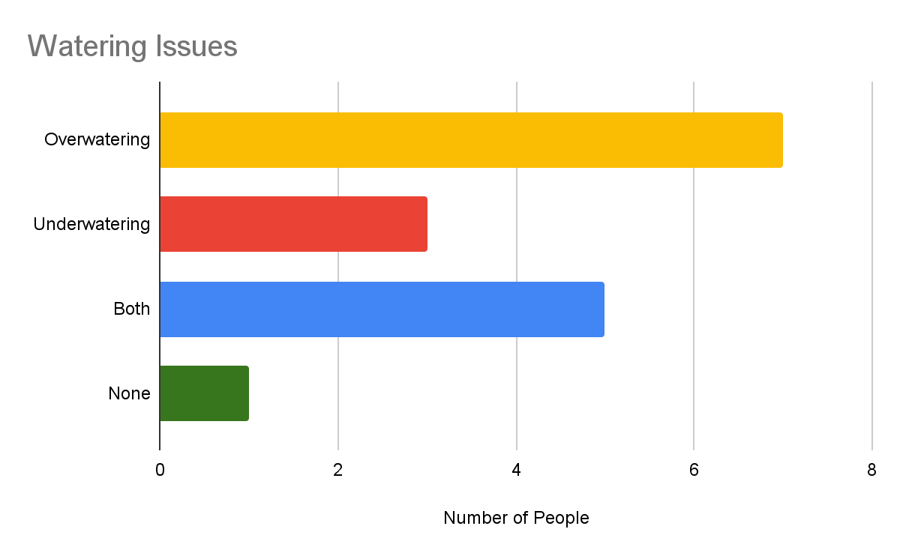
Key Findings
Notes:
A deeper insight on the watering issues. We found that most people dealt with overwatering compared to underwatering, some dealing with both.

Slide 7


Refined Project Idea
Core Idea: Device that passively collects plant information in potted plants and delivers it to users.
Reasoning: People wanted personalized care recommendations and real time information about their plants.
Value Proposition: Provides Plant Centered Data and Tailored Plant Care.
Notes:
Reasoning: People still want personalized care recommendations and real time information about theirs plants. People like being told information and ways to fix problems. On top of this the original plant was too large for the semester so we still knew that we can narrow it down focusing on potted plants and delivering information.
Value Proposition: Our goal is to collect soil information, moisture data, humidity, and other information about the plants providing plant centered data rather than water data. Aside from this we are also interpreting data in the form of a mobile application and dashboard.

Slide 8
Implementation & Features
Primary Features:
Moisture Sensor
Benefit: addresses watering issues
Plant care tips and resources
Benefit: aides beginners, managing pest control
Challenges:
System Integration
Challenge: Send data through sensor to system
Software Integration
Challenge: Process the received data, interpret and display meaningful information to user
Notes:
Outline primary feature and benefits:
- Moisture sensor - aides in the issues of overwatering or underwatering your plants
- Plant care tips - aides in helping beginners figuring out the best practices to care for their plants
Challenges: Highlight any potential challenges in implementing the project.

Slide 9



Feedback & Iteration
Feedback: Personalized Recommendations and Real time monitoring. People faced a lack of knowledge and want plant care tips.
Automated Sprinkler
Notes:
The feedback we received Personalized Recommendations and Real time monitoring. People faced a lack of knowledge and want plant care tips.

Slide 10
Conclusion and Next Steps
Change in Project Idea:
Automated Sprinkler → Moisture Sensor
Key findings from interviewees:
Mainly Female
Diverse Skill Levels
Both Plant Types → Indoor and Outdoor
Issues that they deal with:
Overwatering
Lack of Knowledge
Pests
No Tech in Plant Care
Affordability

